Slide 1
Kaggle Competition Titanic: Machine Learning from Disaster in R
Kapil Bastola
02/22/2017

Slide 2
Content
Introduction
Background
Topic
Usage of Package
Data
Method
Decision Tree
Random Forest
Support Vector Machine
Neural Networks
Logistic Regression
Evaluation
Prediction
Summary

Slide 3
Introduction: Background
Titanic sank in 1915 when it collided with an iceberg
Killed 1502 out of 2224 passengers in the ship
Dataset consists of information regarding passengers in the ship

Slide 4
Introduction: Topic
Using variables like Sex, Class, Age, etc we try to predict whether a passenger survived or not in the titanic disaster
Train dataset are used to build the model and we evaluate the performance of the models with the test dataset.

Slide 5
Introduction: Usage of package
Packages used are
rpart for decision trees
randomForest for Random Forest
e1071 for Support Vector Machines
rattle and rpart.plot for visualizing decision trees
ROCR for area under the curver and ROC curve
SDMTools for calculating confusion.matrix
caret for neural network

Slide 6
Data
There are two group of datasets, the train set and the test set.
Outcome (survived) is provided for the train set
The outcome of test set is given in another

Slide 7
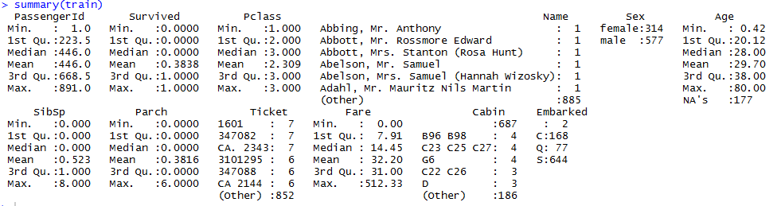
Data
Train Dataset consists of 12 columns and test dataset consists of 11 columns with Survived column missing
Below is the summary of the train dataset

Slide 8
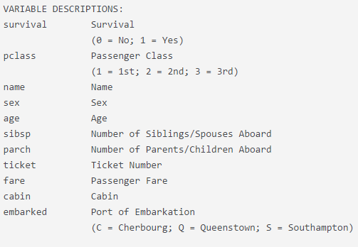
Data
Variable Description

Slide 9

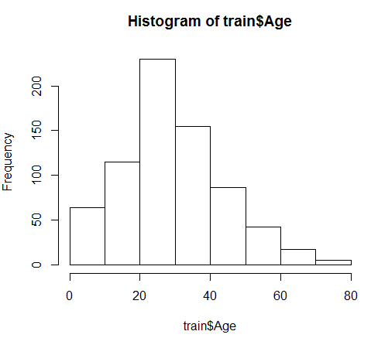

Data
Now we want to see some descriptive statistics from the dataset
Table below shows proportion of female and males and who survived
We see that only 26% of females died while 81% of males died
Similarly looking at proportion of survival based on Class shows that survival was more likely for 3rd passenger class (Lower Class) than for the 1st passenger class (Upper Class)

Slide 10
Method
Since we have labels for our dataset we will use supervised learning algorithms to predict the outcomes.
For the study I have decided to use 5 different classification algorithms, Decision Trees, Random Forest, Support Vector Machines, Neural Networks, and Logistic Regression to predict outcomes
The predicted outcomes will be cross validated with the test set and I will compare the performance of these models using precision, recall, f-measure, and AUC.

Slide 11

Method
Decision Tree
Created a fit using rpart package
Used Survived as the outcome variable and other numerical and categorial variables as classes
Predicted the outcome of test dataset using predict function
Calculated the confusion matrix and performance of the model

Slide 12
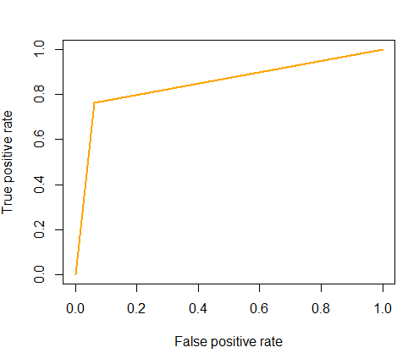

Method
Decision Tree

Slide 13
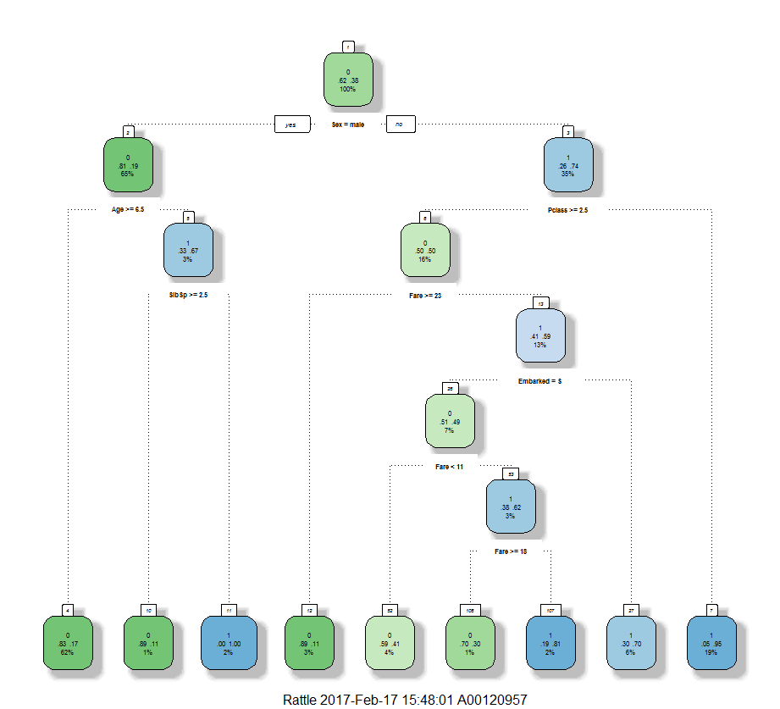

Slide 14
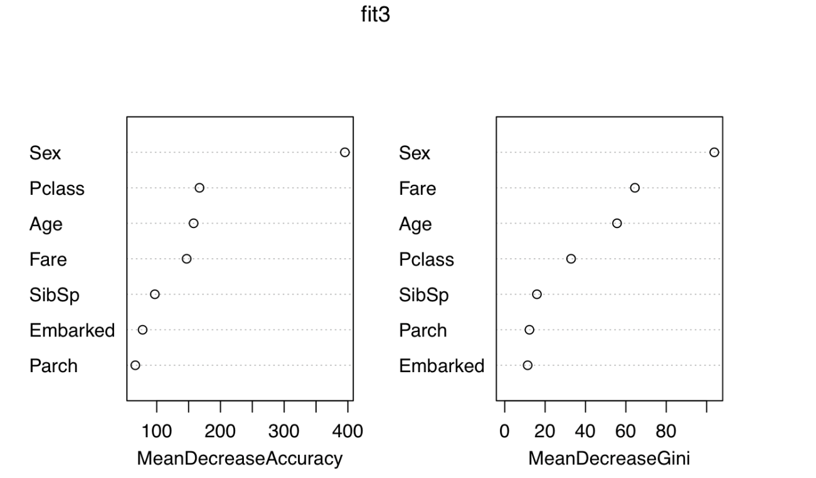
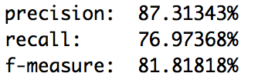
Method
Random Forest
Ran random forest algorithm using randomForest library

Slide 15
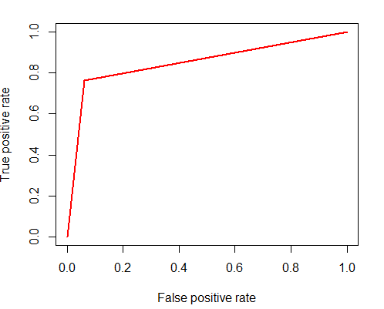

Method
Random Forest

Slide 16
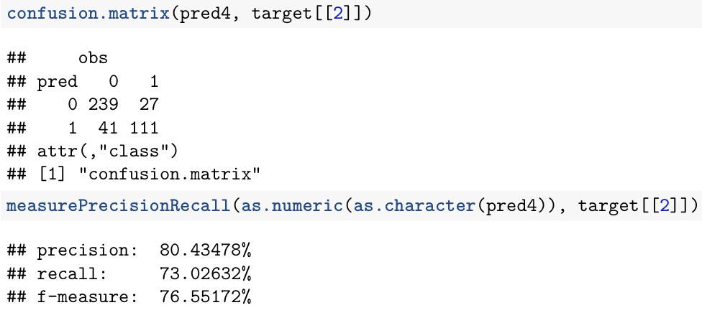
Method
Support Vector Machine
Did SVM model using e1701 library and evaluated the model with test dataset.

Slide 17
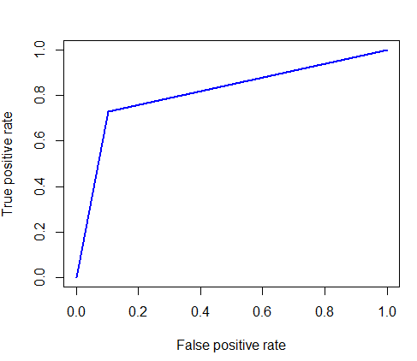

Method
Support Vector Machines

Slide 18
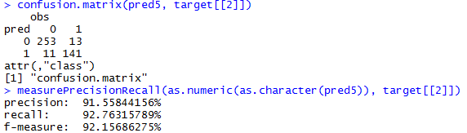
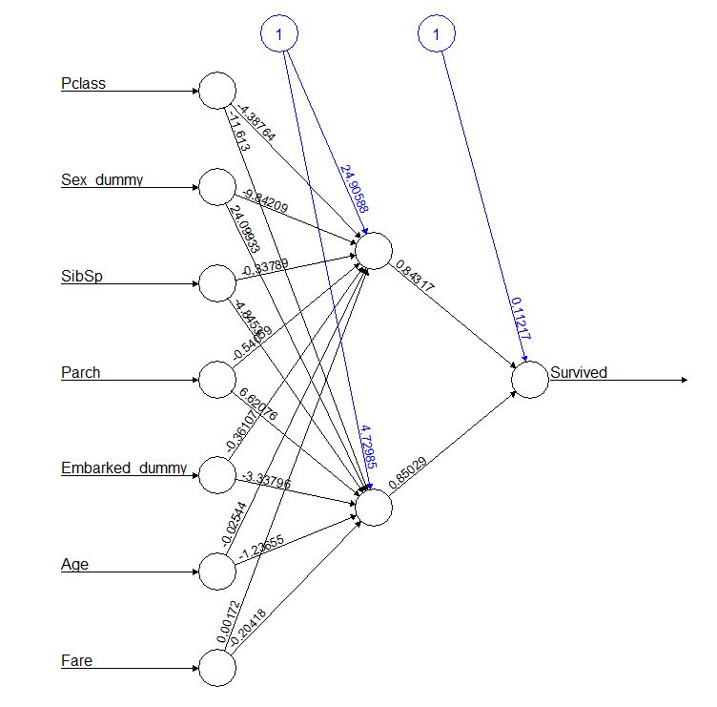
Method
Neural Networks

Slide 19
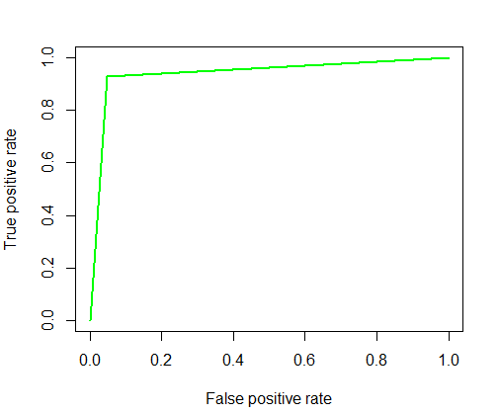

Method
Neural Networks

Slide 20
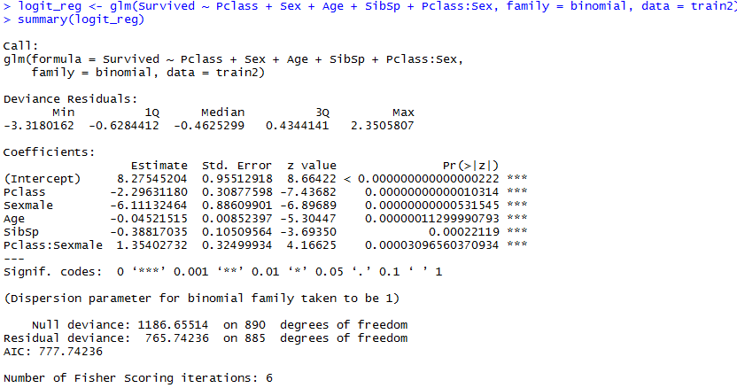

Method
Logistic Regression

Slide 21
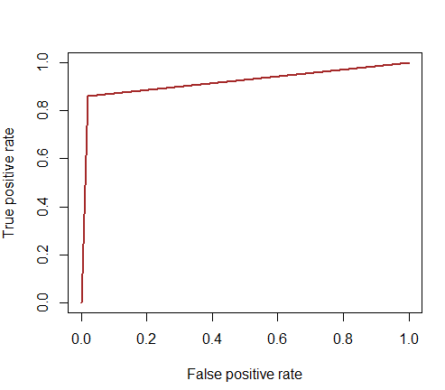

Method
Logistic Regression

Slide 22

Evaluation
Neural Network comes out as the winner amongst the models when we look at the performance of the models in the test dataset.

Slide 23
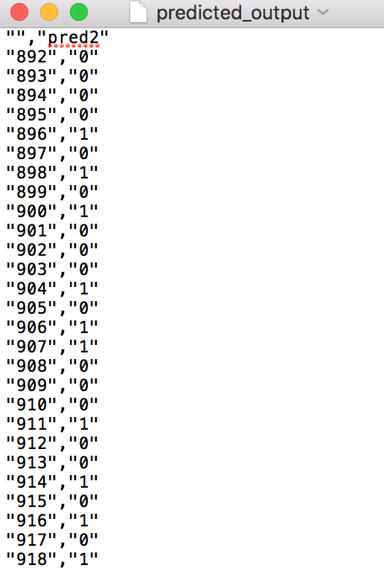
Prediction
Since decision tree was clear winner we use the predicted value from this algorithm to create a CSV file called predicted_output as our prediction

Slide 24
Summary
Comparing the 5 models we see that for this dataset Neural Network is the best algorithm to predict the survival in titanic disaster.

